Slide 1
Introduction to Information Literacy
How to successfully conduct research.
University of South Dakota Library. University of South Dakota, 2013. Web. 01 Oct. 2013.

Slide 2
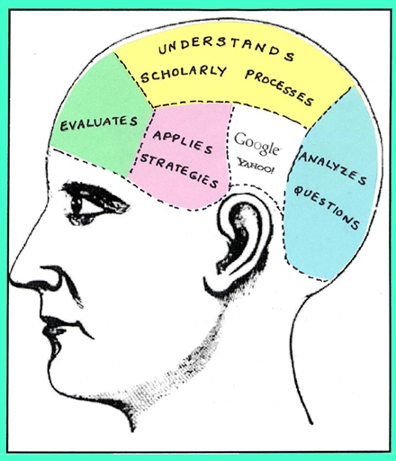
What is Information Literacy?
Information literacy is the ability to successfully find, retrieve, analyze, and use research or information for an academic purpose.
It is a refined set of research skills that help you find credible and helpful resources.
It can be broken up into 4 categories
Research Skills
Database Skills
Web Evaluation Skills
Academic Integrity Skills

Slide 3
Why learn about Information literacy?
By being well-versed and literate in the ways of finding and presenting information, your instructors, readers, peers, employers, and co-workers will see you as a professional and confident worker.
This, in turn, will lead to advancements in the workplace, new responsibilities, and trust.
You will be the “go-to” person.
Essentially, these skills will not only help you be successful in this composition class, but they will also help you be successful in your career goals.

Slide 4
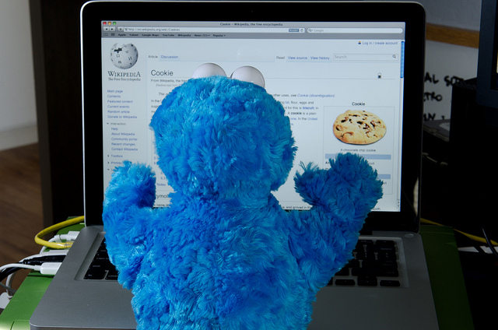
Importance of Research
During the research unit we will discuss..
How to get started
Where to get started
Different formats of research
Finding a research style that works best for you
Hands on experience

Slide 5

Importance of Database
During the database unit we will discuss…
What a database is
How it differs from search engines
Where reliable databases are located
How to use a database
Tips and tricks

Slide 6

Importance of Web Evaluation
During the web evaluation unit we will discuss…
How to effectively evaluate websites
What makes a site credible/not credible
Differentiate book sources and web sites
Search engines
Proper criteria for evaluating a web site

Slide 7
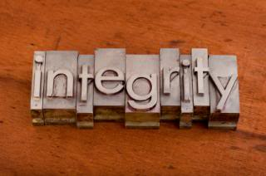
Importance of Academic Integrity
During the academic integrity unit we will discuss…
Plagiarism
Common knowledge
Why proper citation is important
Direct quotations
Summary
Paraphrasing
When to cite a source

Slide 8
Information Literacy
Pre-Test
“Information Literacy Pre-Test.” Madonna University Library. Madonna University, n.d. Web. 13 Oct. 2013

Slide 9
Question 1
I read a book for a course I was taking at Southeast Technical Institute. It contained the footnote:
Bonilla-Silva, E. (1997). Rethinking racism: Toward a structural interpretation. American Sociological Review, 62, 465-480.
This citation is for…
A. a book
B. a journal
C. a journal Article
D. a website

Slide 10
Question 2
When searching in a research database, the use of Boolean operators "And", "Or" and "Not" can be useful in narrowing or widening your search results. Which word would you use to increase the number of the items you will retrieve?
A. And
B. Or
C. Not
D. All of them

Slide 11
Question 3
A Primary Source is…
A. A document like a diary, letter, etc…
B. The first book or journal article written about a topic.
C. An article or book that extensively analyzes a topic.
D. A collection of critical essays.

Slide 12
Question 4
Failure to give credit to your sources of information is called…
A. Copyright
B. Plagiarism
C. Partial citation
D. Abstracting

Slide 13
Question 5
Google is…
A. a book
B. an Internet search engine
C. an online catalogue
D. a research database

Slide 14
Question 6
An abstract is…
A. a quote from a book.
B. a full text article.
C. a type of government document.
D. a summary of a resource.

Slide 15
Question 7
What is the BEST way to search for books on a given topic?
A. Author or title
B. Publisher or call number
C. ISSN or ISBN
D. Keyword or subject

Slide 16
Question 8
Which is the best place to find research published by scholars, experts or professionals?
A. Amazon.com
B. In the newspapers
C. In general interest magazines
D. In books and scholarly journals

Slide 17
Question 9
APA and MLA both refer to…
A. Library classification systems
B. Formats for documenting the sources used for a paper
C. Call numbers
D. Article indexes

Slide 18
Question 10
In critically evaluating information sources you should consider all but…
A. The timeliness of the information.
B. The credentials of the author.
C. The length of the information source.
D. The accuracy of the information.

Slide 19
Question 1
I read a book for a course I was taking at Southeast Technical Institute. It contained the footnote:
Bonilla-Silva, E. (1997). Rethinking racism: Toward a structural interpretation. American Sociological Review, 62, 465-480.
This citation is for…
A. a book
B. a journal
C. a journal Article
D. a website

Slide 20
Question 2
When searching in a research database, the use of Boolean operators "And", "Or" and "Not" can be useful in narrowing or widening your search results. Which word would you use to increase the number of the items you will retrieve?
A. And
B. Or
C. Not
D. All of them

Slide 21
Question 3
A Primary Source is…
A. A document like a diary, letter, etc…
B. The first book or journal article written about a topic.
C. An article or book that extensively analyzes a topic.
D. A collection of critical essays.

Slide 22
Failure to give credit to your sources of information is called…
A. Copyright
B. Plagiarism
C. Partial citation
D. Abstracting

Slide 23
Question 5
Google is…
A. a book
B. an Internet search engine
C. an online catalogue
D. a research database

Slide 24
Question 6
An abstract is…
A. a quote from a book.
B. a full text article.
C. a type of government document.
D. a summary of a resource.

Slide 25
Question 7
What is the BEST way to search for books on a given topic?
A. Author or title
B. Publisher or call number
C. ISSN or ISBN
D. Keyword or subject

Slide 26
Question 8
Which is the best place to find research published by scholars, experts or professionals?
A. Amazon.com
B. In the newspapers
C. In general interest magazines
D. In books and scholarly journals

Slide 27
Question 9
APA and MLA both refer to…
A. Library classification systems
B. Formats for documenting the sources used for a paper
C. Call numbers
D. Article indexes

Slide 28
Question 10
In critically evaluating information sources you should consider all except…
A. The timeliness of the information.
B. The credentials of the author.
C. The length of the information source.
D. The accuracy of the information.

